Slide 1
Surveying the stars
Chapter 15, The Cosmic Perspective
Notes:
Melotte 15

Slide 2
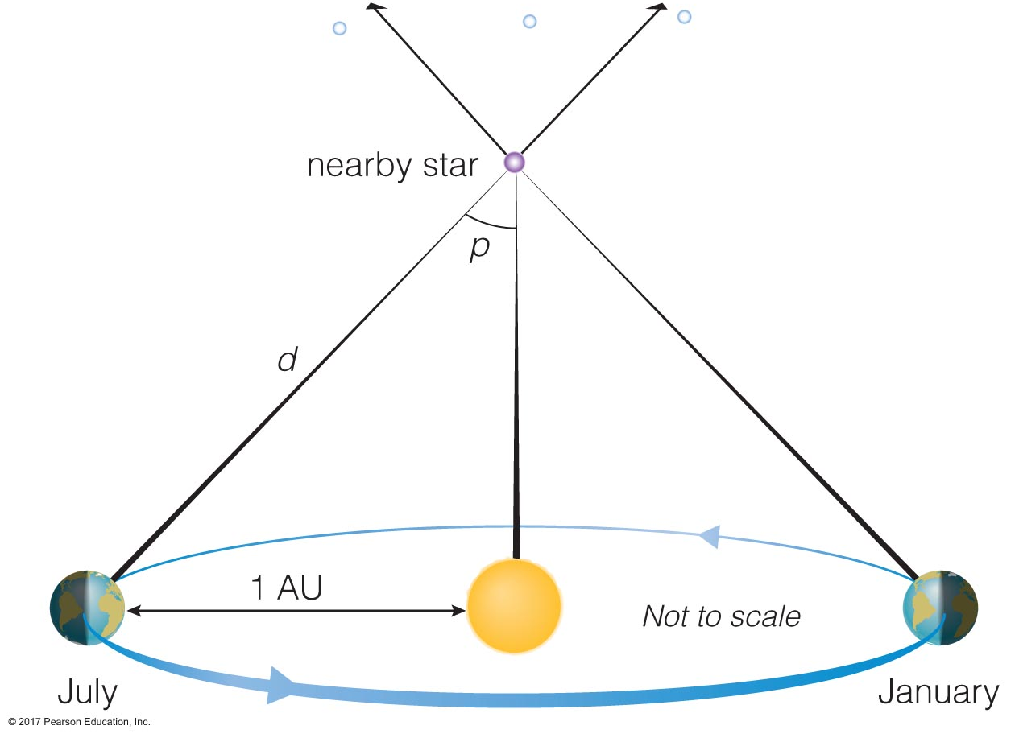
Recap from last time: parallax
d (in pc) = 1 / p (in arcsec)
Example: a star with a parallax angle of 0.5 arcsec
d = 1 / (0.5”) = 2pc
Example: a star with a parallax angle of 0.1”
d = 1 / (0.1”) = 10pc
Parsecs take prefixes like other SI units:
1000pc = 1kpc
1,000,000pc = 1Mpc
1pc = 3.26ly
Notes:
Notice as the parallax angle gets smaller, the distance gets bigger… does this make sense?

Slide 3
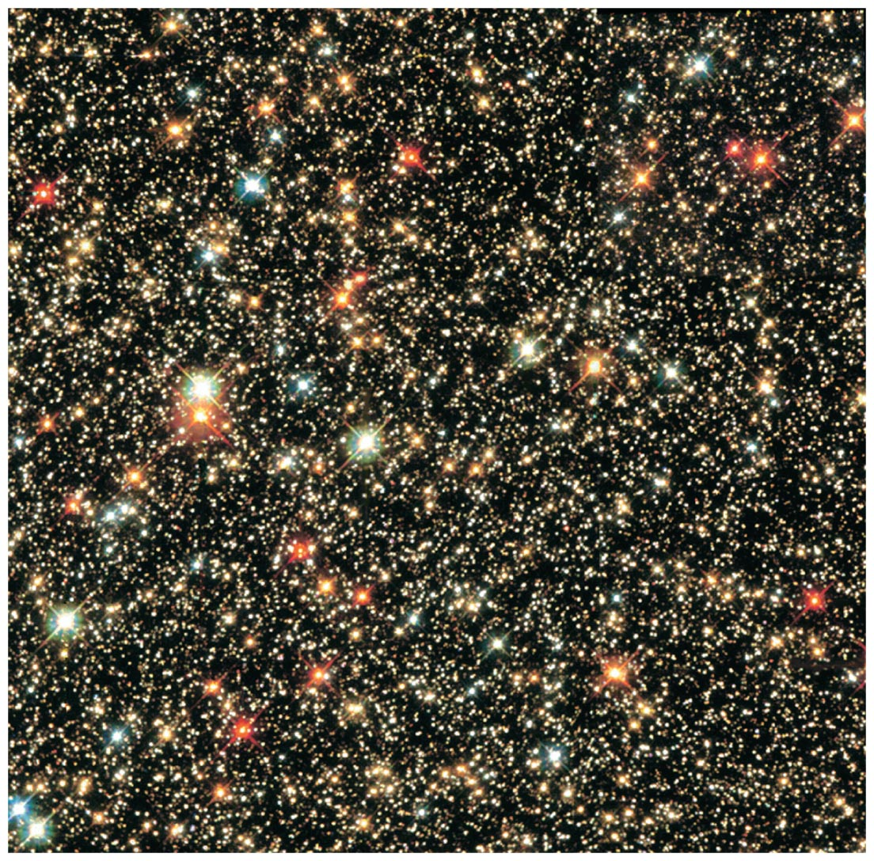
Patterns in stars
What do you notice about this picture?
Stars are in a cluster: assume they’re all at about the same distance
Biggest, brightest ones are red or blue-white
Rest are different sizes, some blue, most yellow-white-ish, some small red dots
There’s some kind of relationship between stars’ color and luminosity
Notes:
More about this.. Next time.

Slide 4
Stellar temperature
We see the stellar surface, and can only directly measure its temperature
Recall from thermal radiation: peak wavelength depends on the temperature of the object
Wavelength vs color
Notes:
(this is where we stopped)

Slide 5
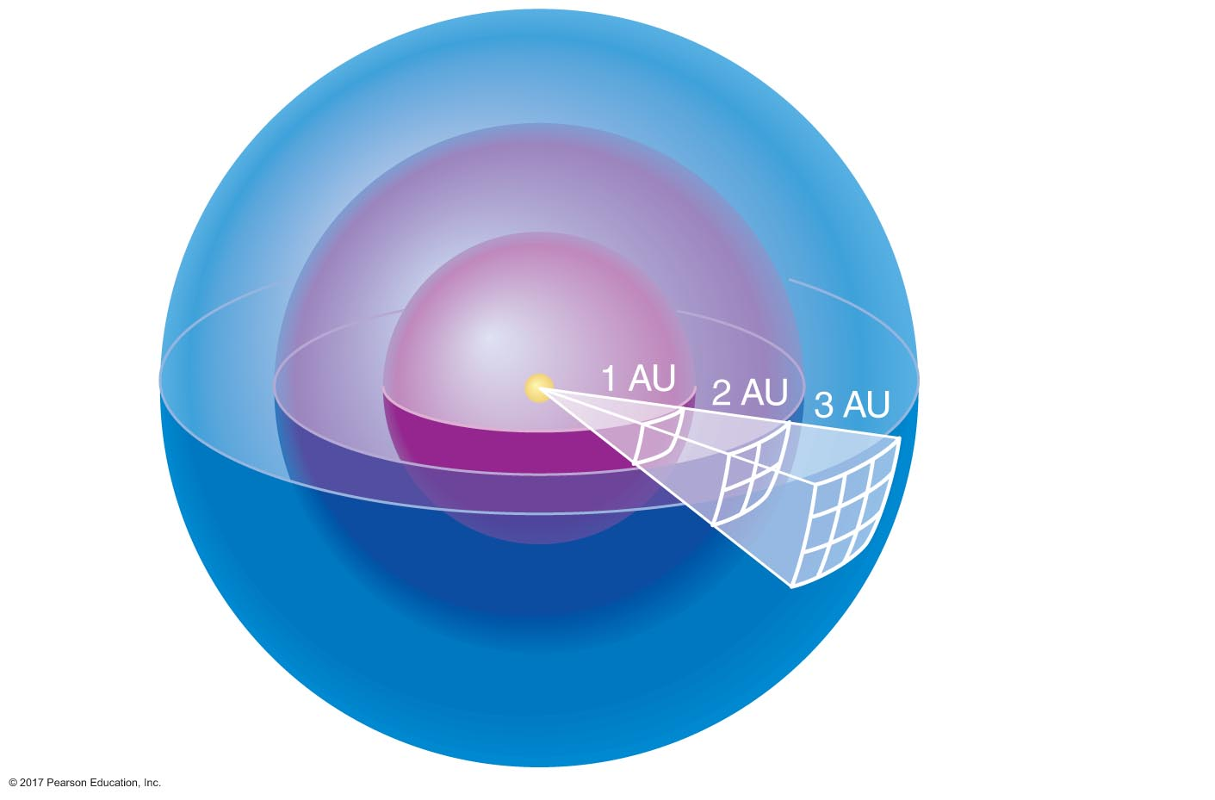
Apparent magnitude, absolute magnitude, luminosity
Apparent magnitude is how it appears to us on the sky
Light decreases with distance as 1/r²
Decreases due to dust/gas in line of sight scattering, absorbing
Absolute magnitude: what is magnitude if you take apparent magnitude and assume star is at 10pc
This is actually quite close-- Proxima Centauri is 1.3 pc, or 4.2 ly away
Luminosity is how bright the star is right next to it: how much power is it emitting over its surface
Luminosity depends on both the power emitted and the surface area of the star
L = 4πr²σT⁴ → recall Stefan-Boltzmann law for power emitted by thermal radiation

Slide 6
Spectral types
Can roughly tell a star’s temperature based on two different colors of light. Can more precisely tell from its spectrum!
Before we knew about quantum mechanics, we measured and classified stellar spectra
And by “we,” I mean…
Notes:
https://www.space.com/34707-annie-jump-cannon-biography.html

Slide 7
The ”computers”
Notes:
Often women’s college graduates who were not allowed to obtain degrees or jobs in science fields.. Hired because they could be paid less. Hiring women at all in the first place was a cynical precedent set by an exasperated man in power
https://www.sciencenews.org/article/astronomys-unsung-heroines-celebrated-glass-universe

Slide 8
Spectral types
How would you go about sorting something when you don’t know what it is?
Size
Shape
Color
…
The “computers” sorted on all these things. Were lines present? Yes, no. Are they weak, or strong?

Slide 9
Spectral types
“Pickering had turned to women out of exasperation with a male assistant. Declaring that even his maid could do a better job, he hired Williammina P. Fleming, a twenty-four year old Scottish immigrant, to assist him.” –The Perfect Machine: Building the Palomar Telescope, Ronald Florence (p. 13-14)
Paid half the rate a man would earn, Williammina/Wilhelmina Fleming was a BOSS. She discovered and catalogued over 10,000 stars, nebulae, and the existence of white dwarf stars.
worked to define a spectral order
Gave spectra letters based on strength of Hydrogen lines
She also oversaw the work of Annie Jump Cannon and Henrietta Swan Leavitt
Notes:
https://www.atlasobscura.com/articles/how-female-computers-mapped-the-universe-and-brought-america-to-the-moon

Slide 10
Spectral types
Annie Jump Cannon
Defined spectral sequence as we know it today
Sorted sequence in order of descending stellar surface temperature
Divided into sub-classes: A0, A1, A2, etc: higher number → lower surface temperature
Classified over 400,000 spectra over her career
Why don’t we know her name? (Spoiler: who paid for the catalog? Henry Draper/his estate)
The sequence was visually clear, but it wasn’t known why stars were in this order until Cecilia Payne-Gaposchkin realized stellar composition was mostly H, He, and surface temperature determined properties of stellar spectra
Henrietta Swan Leavitt discovered Cepheid variables: regularly pulsating stars, periods related to luminosity
Notes:
https://www.atlasobscura.com/articles/how-female-computers-mapped-the-universe-and-brought-america-to-the-moon

Slide 11
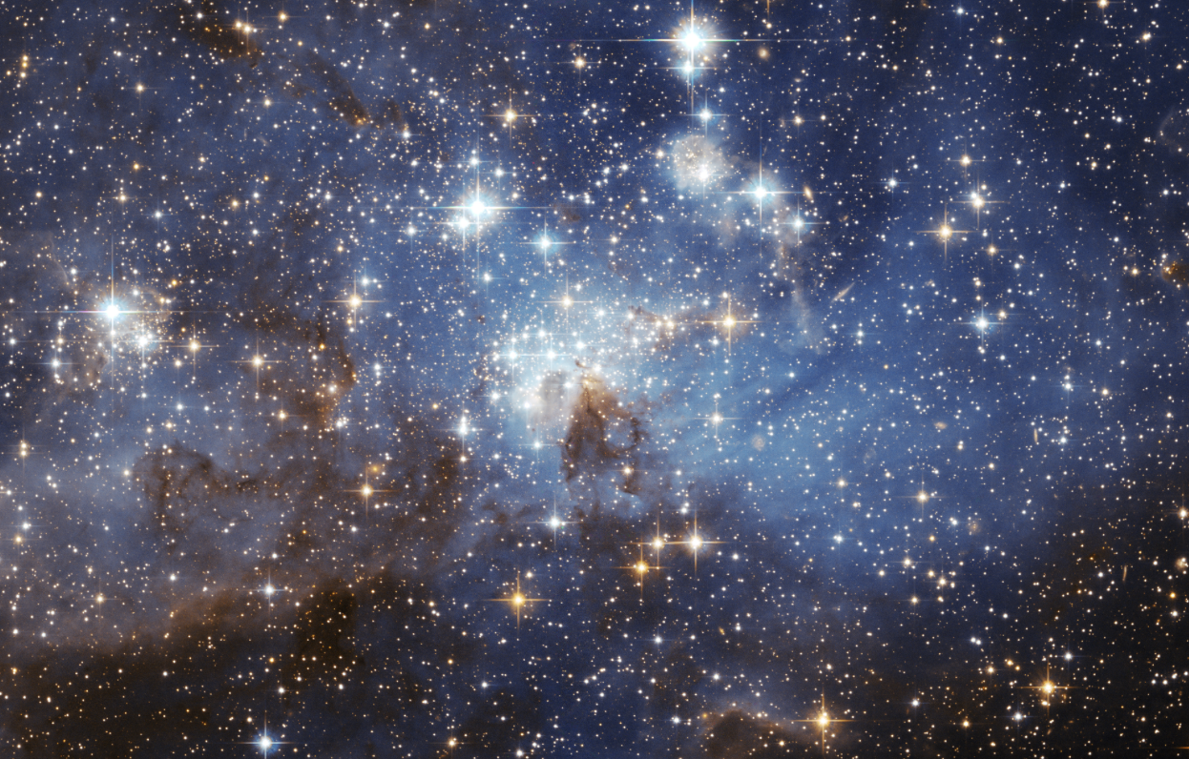
Stellar masses
How might we measure stellar masses?
Notes:
Can’t put a star on a scale… what do we know about right now that could allow us to measure a star’s mass?

Slide 12
Stellar masses
How might we measure stellar masses?
F_{g}! Gravitational interactions!
With what?
Binary stars! Almost half of all stars are in binaries.
Visual
Spectroscopic
Eclipsing
Notes:
Can’t put a star on a scale…

Slide 13
The H-R diagram
How would you organize stars?
Colors
Spectra
Brightness
What if these things were related to each other somehow?

Slide 14
Notes:
https://en.wikipedia.org/wiki/Hertzsprung–Russell_diagram#/media/File:HRDiagram.png
Got here in last lecture

